Slide 1
Graphical Excellence
Part I

Slide 2
“Well-designed presentations of interesting data are a matter of substance, of statistics, and of design.”
--Edward R. Tufte
https://thedoublethink.com/tuftes-principles-for-visualizing-quantitative-information/
https://flowingdata.com/2017/02/09/how-to-spot-visualization-lies/

Slide 3
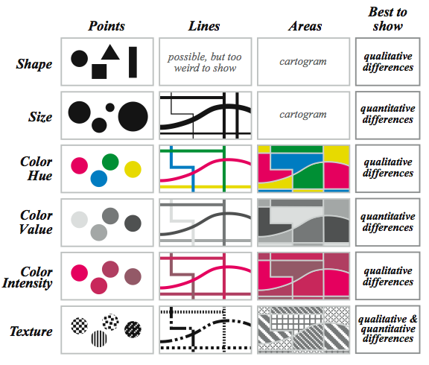
Basic Design Elements
http://understandinggraphics.com/visualizations/information-display-tips/

Slide 4
Violations of Graphical Integrity:
The Lie Factor
Scale Distortions and Disappearing Baseline
Design Distortions
Different Dimensions in Data and Graphic
Failing to Correct for Inflation
Lack of Context

Slide 5
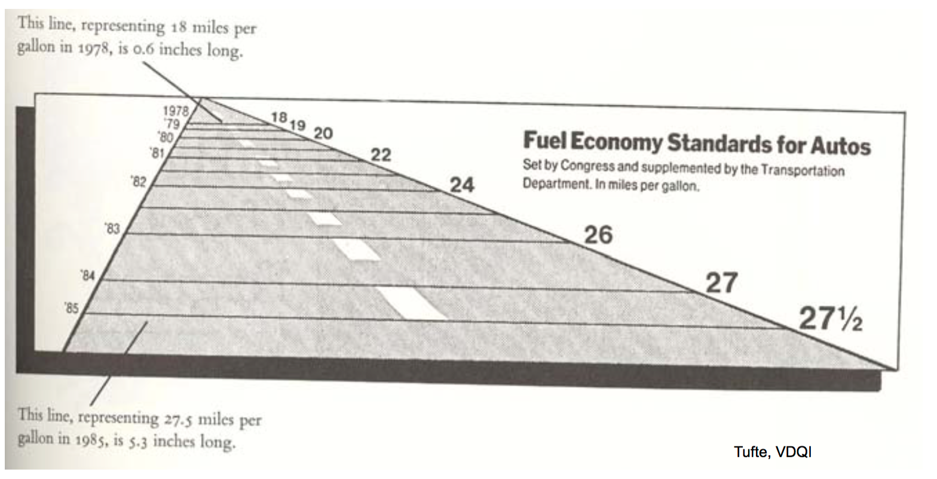
Anything wrong with this graph?

Slide 6
1. The Lie Factor:

Slide 7
1. The Lie Factor:
(Size* of effect in graphic) / (Size of effect in data)
Where Size is: (First value – Second value) / Second value
Ideally, it should be close to 1,
Tufte says: 0.95 to 1.05

Slide 8
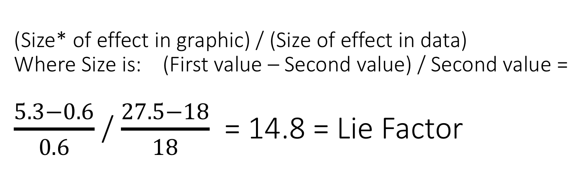
(Size* of effect in graphic) / (Size of effect in data) Where Size is: (First value – Second value) / Second value = $\frac{5.3−0.6}{0.6}$ / $\frac{27.5−18}{18}$ = 14.8 = Lie Factor

Slide 9
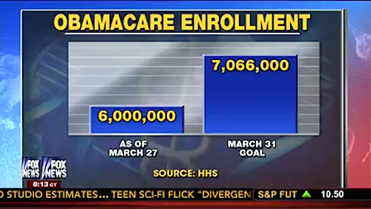
1. The Lie Factor:
Try this one:

Slide 10
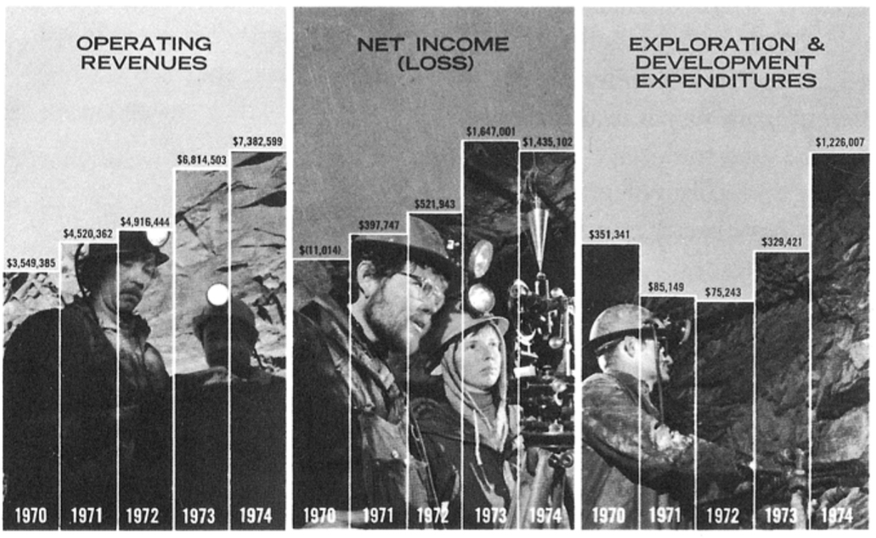
2. Scale Distortions and Disappearing Baseline

Slide 11
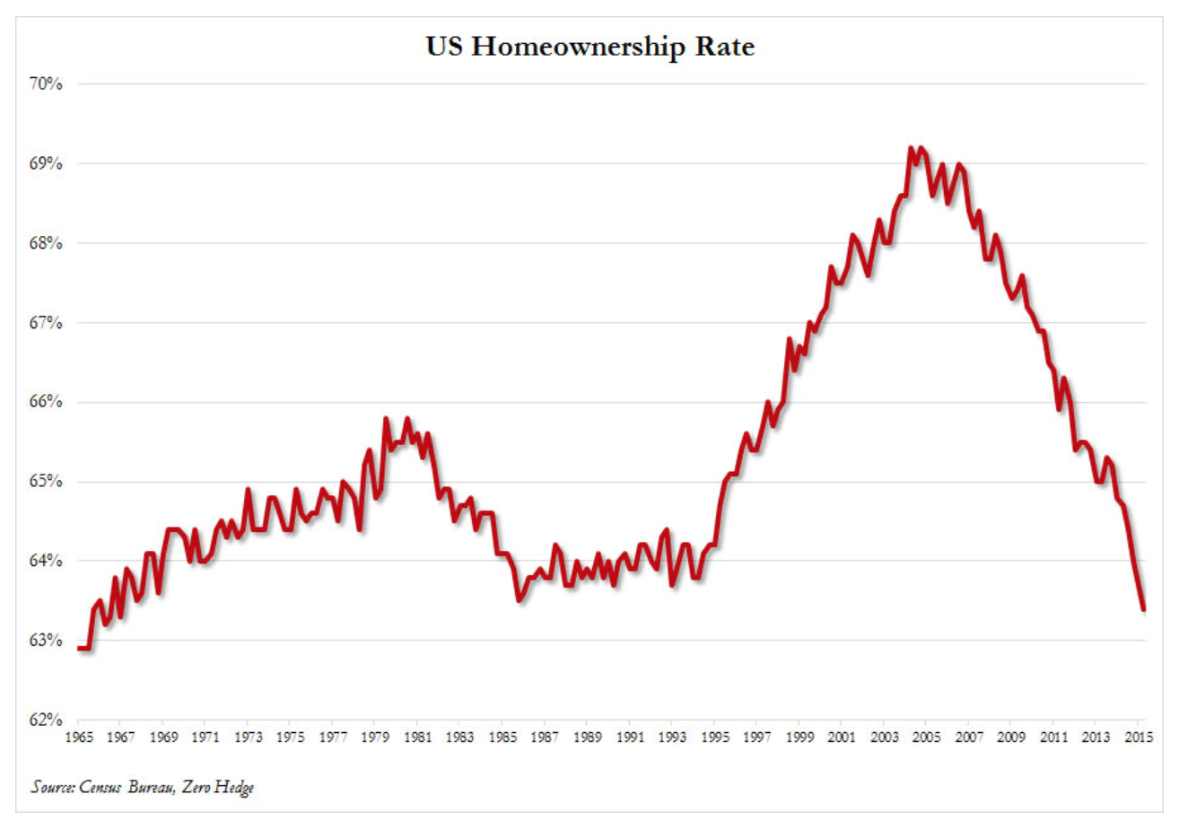
2. Scale Distortions and Disappearing Baseline

Slide 12
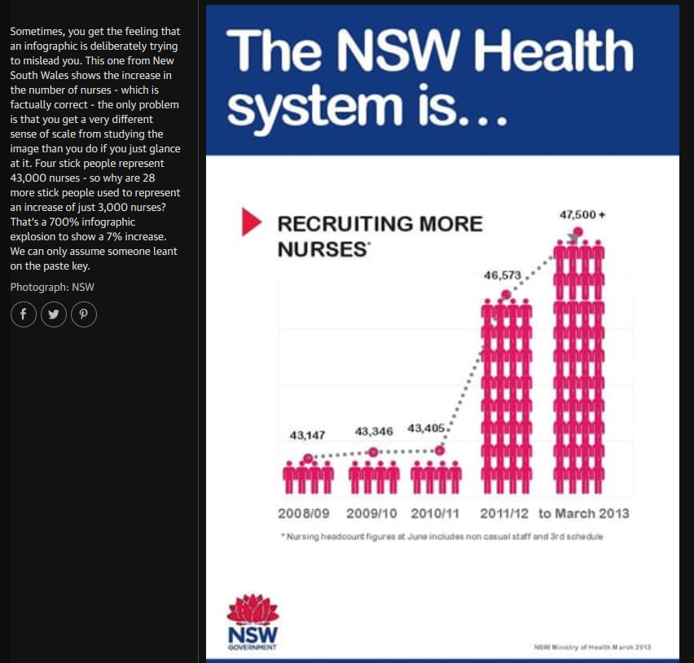
2. Scale Distortions and Disappearing Baseline

Slide 13
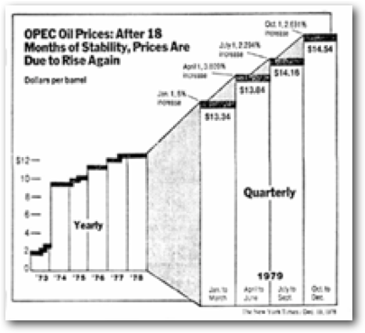
3. Design Distortions

Slide 14
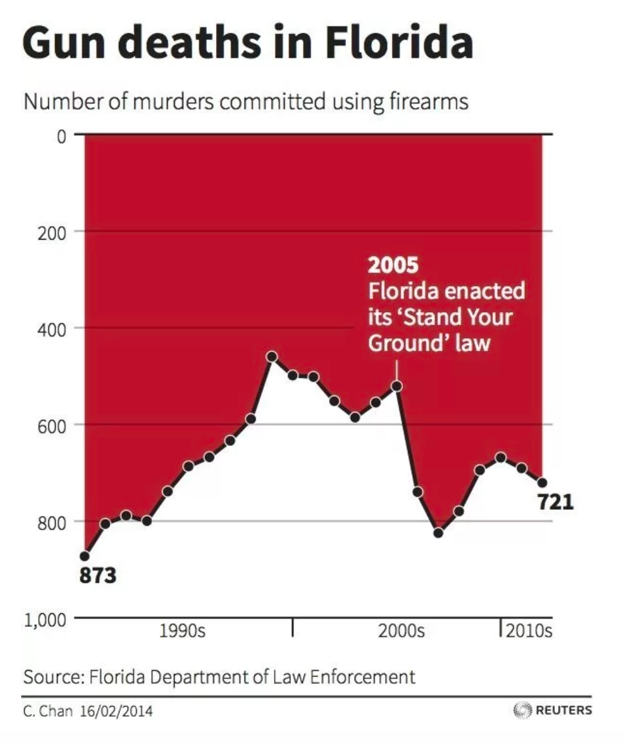
3. Design Distortions

Slide 15
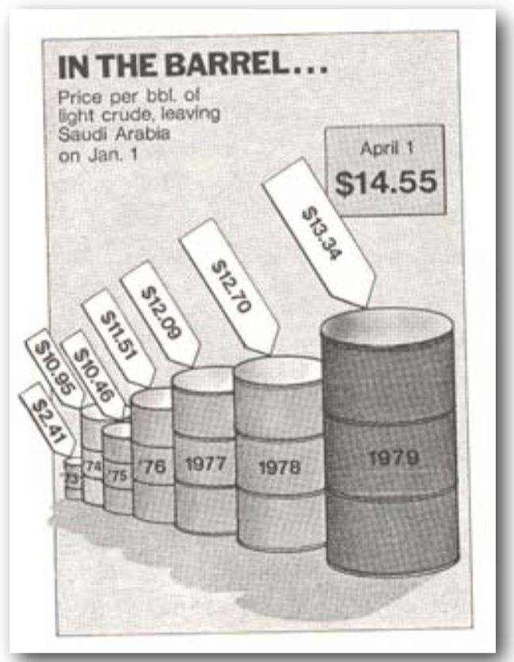
4. Different Dimensions in Data and Graphic

Slide 16
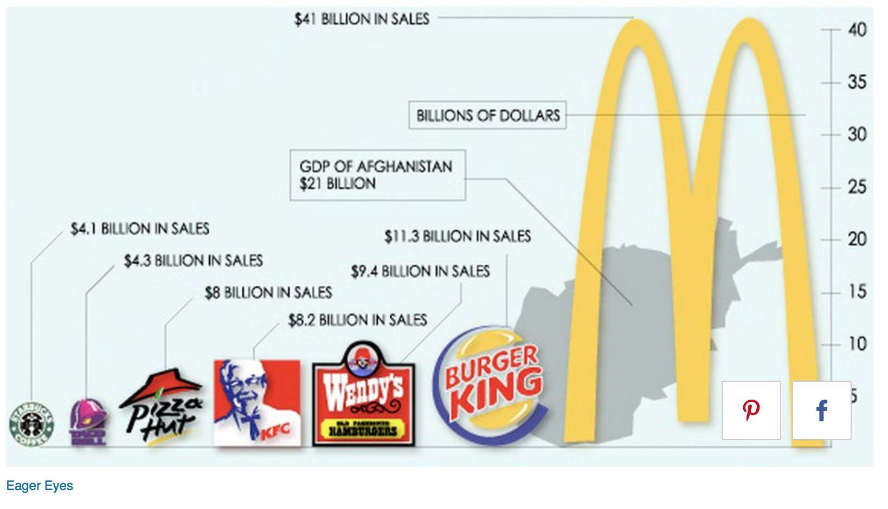
4. Different Dimensions in Data and Graphic

Slide 17
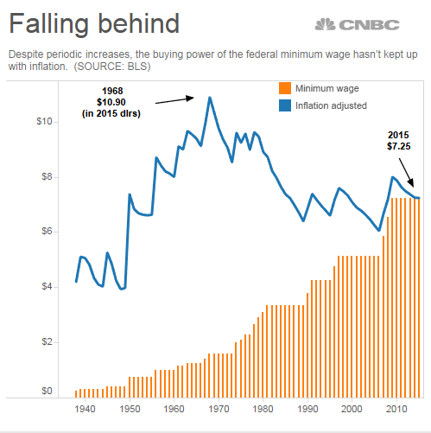
5. Failing to Correct for Inflation
https://people.duke.edu/~rnau/411infla.htm
https://www.cnbc.com/2016/07/21/adjusted-for-inflation-the-federal-minimum-wage-is-worth-less-than-50-years-ago.html

Slide 18
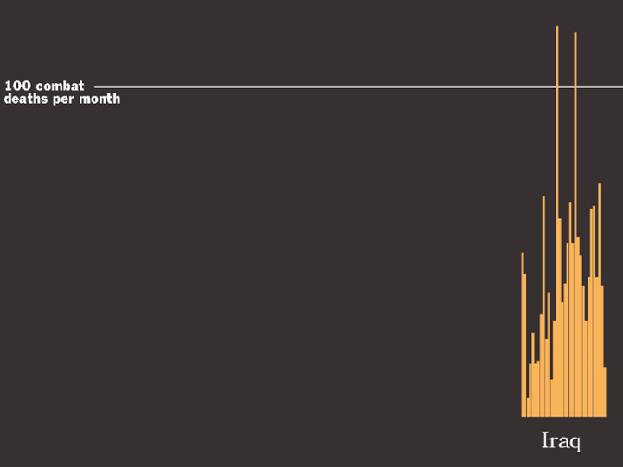
6. Lack of Context

Slide 19
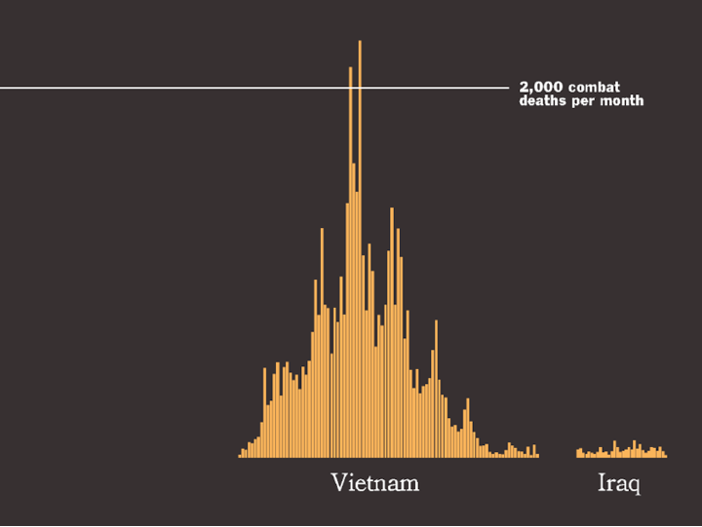
6. Lack of Context

Slide 20
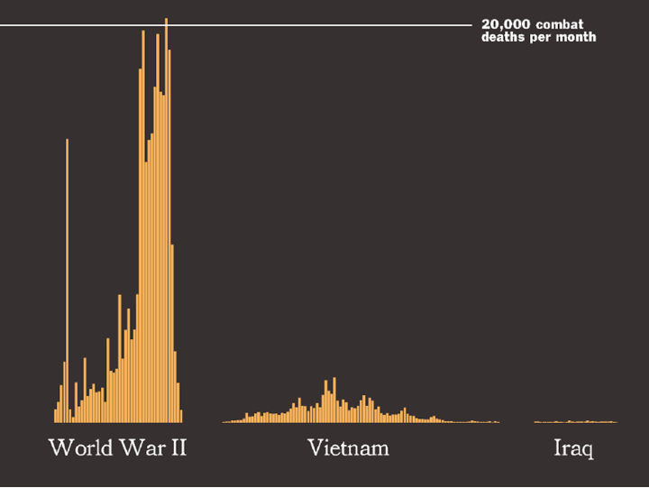
6. Lack of Context

Slide 21
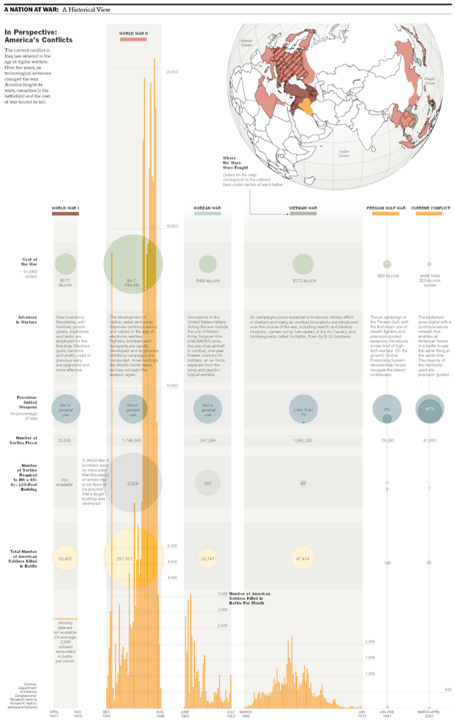

Slide 22
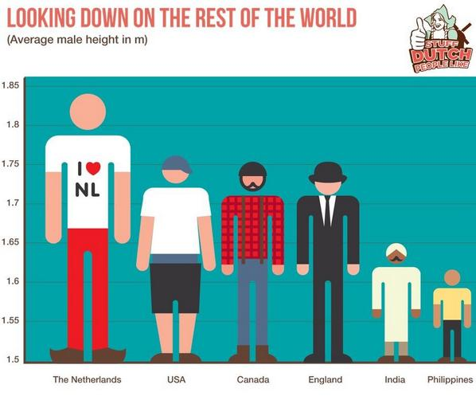
Any problems with this graph?

Slide 23
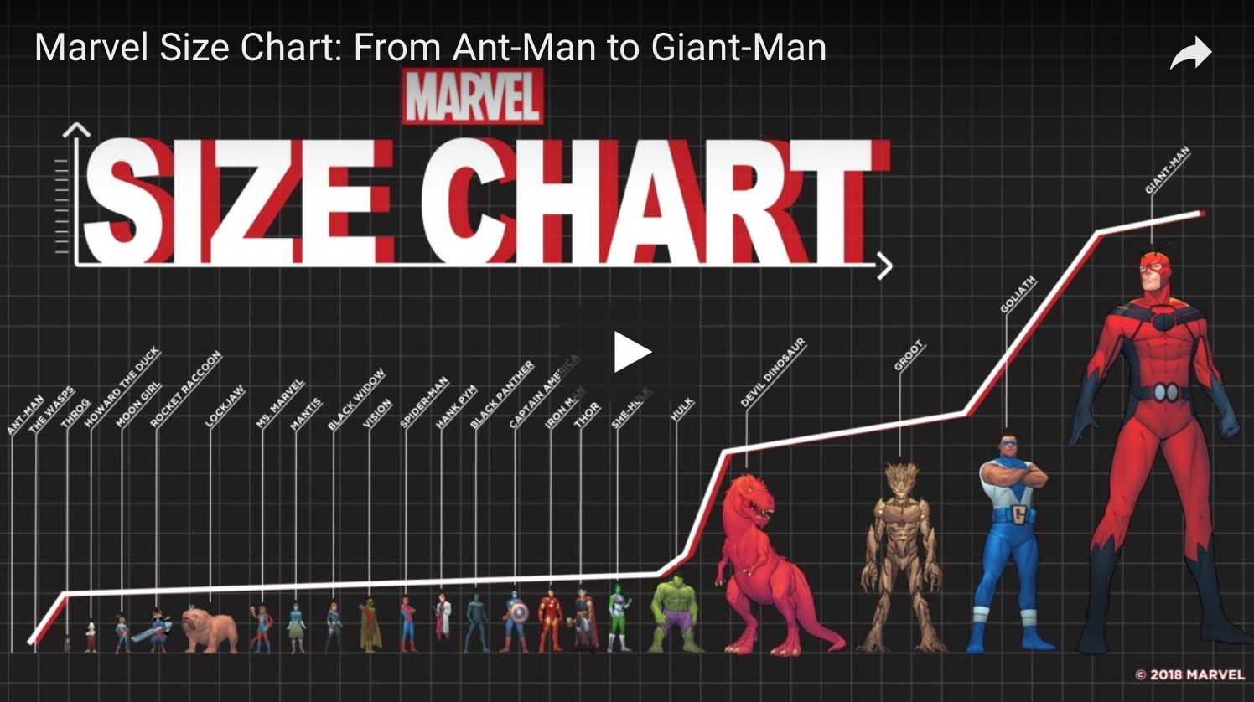
Or this?
https://flowingdata.com/2018/07/22/marvel-size-chart/

Slide 24
More graphical mistakes to avoid, from The Elements of Data Analytic Style, by Jeff Leek:
Using a color palette that colorblind people can’t see
Using colors that look too similar to each other
Not making scatterplots when you should (using something more complicated or more summarized, like boxplots)
Failing to take logs when data is very right-skewed
Using some standard graph instead of focusing on the point of the graph.
Lining up facets vertically when they should be horizontal – be sure to line up so the important comparison can be made..

Slide 25
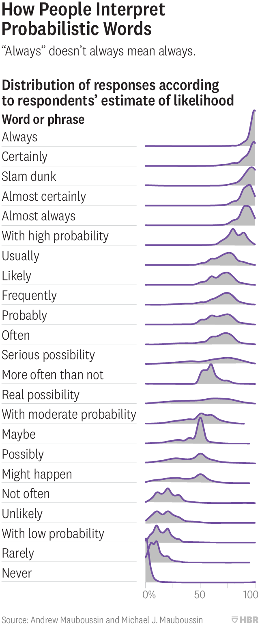
Horizontal Facets: (from https://hbr.org/2018/07/if-you-say-something-is-likely-how-likely-do-people-think-it-is

